Slide 1


Slide 2

THE PROBLEM: RENTING IS BROKEN
High Prices on rental platforms like AirBnb
Searchability/transparency with Facebook/real estate agents
Trust issues to send international payment for deposit

Slide 3
THE SOLUTION: RWAs POWER SMART RENTALS
Market Prices
Transparent (blockchain)
Trust (payment)

Slide 4
HOW IT WORKS
DEMO flow

Slide 5

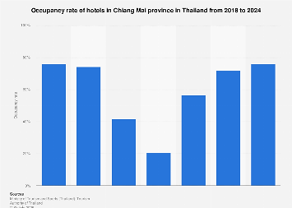
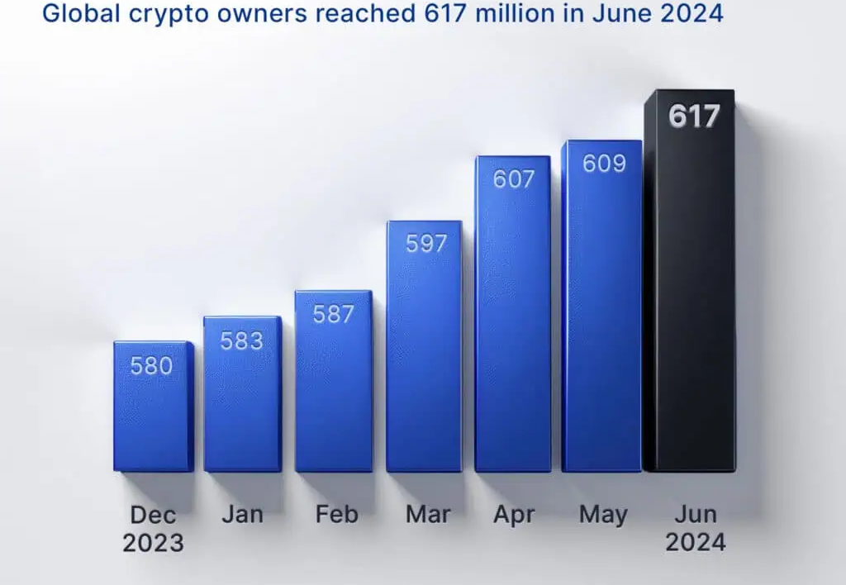
Occupancy rate of hotels in Chiang Mai province
why NOW
2021
2022
2023
2024

Slide 6
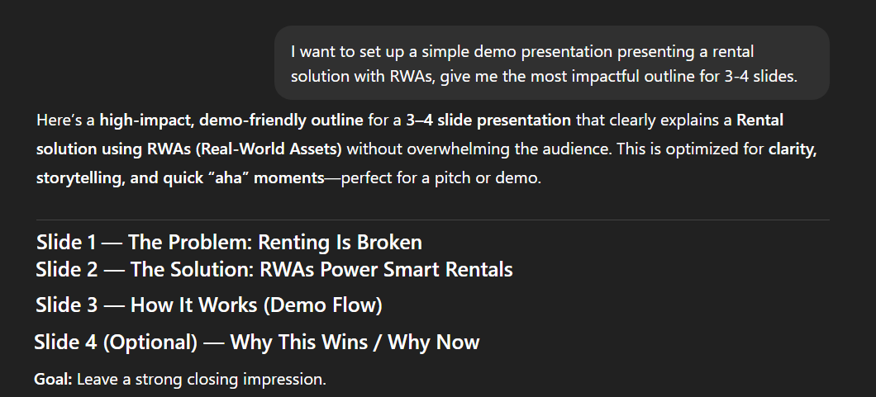

AI USECASES

